Slide 1
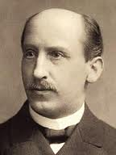
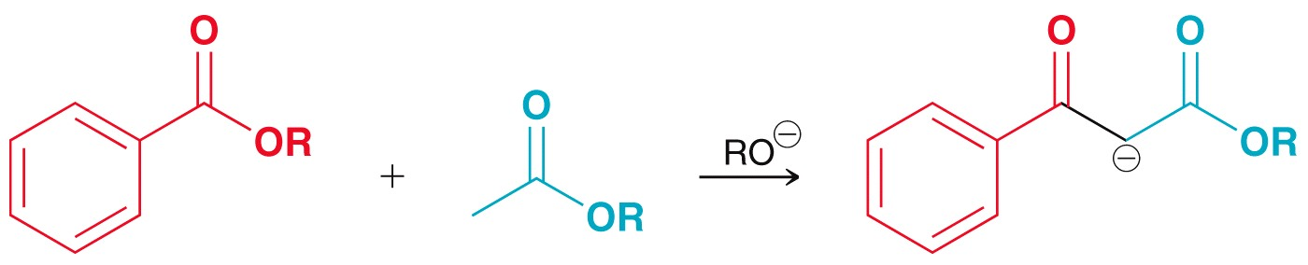
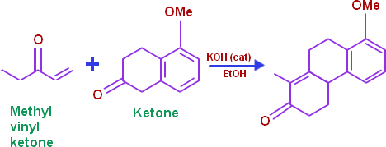
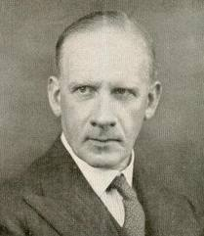
Rainer Ludwig Claisen (January 14, 1851 - January 5, 1930) was a German chemist who developed condensations of carbonyls (Claisen condensation) and sigmatropic rearrangements.
SECTION IX (CHAP. 22)
ALPHA PROTON CHEMISTRY
Sir Robert Robinson (13 September 1886 – 8 February 1975) was an British Organic Chemist and 1947 Nobel Prize winner for his research on plant dyestuffs (anthocyanins) and alkaloids.

Slide 2
FUNDAMENTAL CONCEPTS
Tautomeriztion
Alpha halogenation
Alpha alkylation
Aldol condensation
Claisen condensation
Michael addition
Robinson annulation

Slide 3
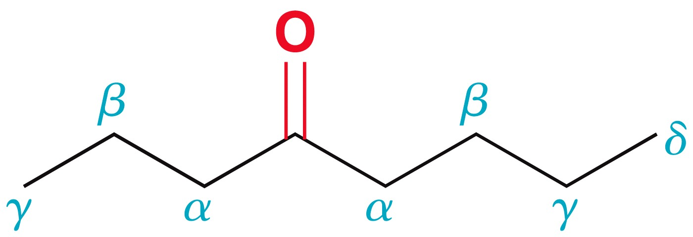
TAUTOMERIZATION
For carbonyl compounds, Greek letters are often used to describe the proximity of atoms to the carbonyl center.
This chapter will primarily explore reactions that take place at the alpha carbon.
Trace amounts of acid or base catalyst provide equilibriums in which both the enol and keto forms are present.
This interconversion of isomers that occur through the migration of a proton and the movement of a double bond is called Tautomerization.
Tautomers are not resonance form

Slide 4
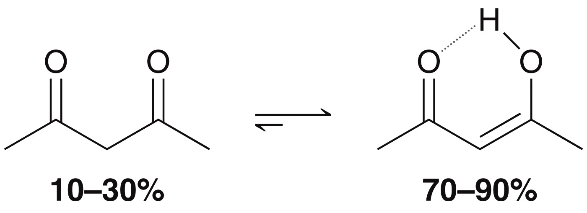
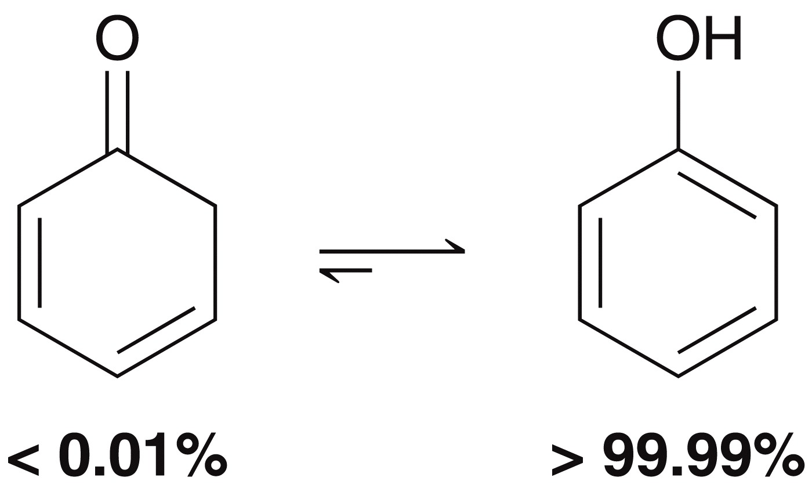
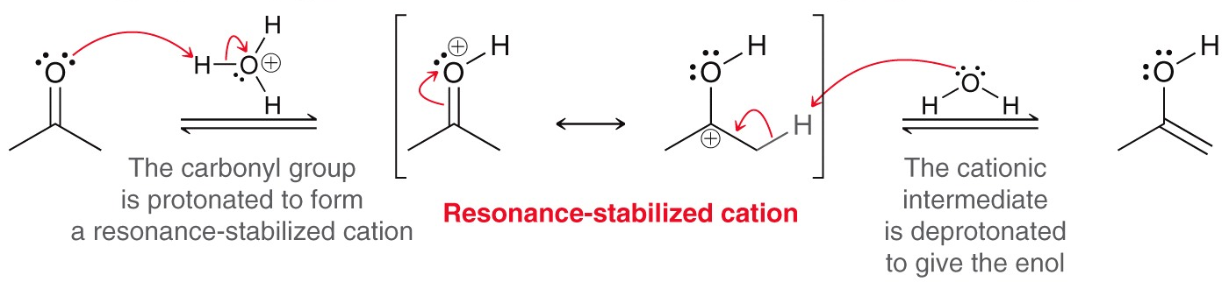
TAUTOMERIZATION
In rare cases such as the example below, the enol form is favored in equilibrium.
Phenol is another example where the enol is vastly favored over the keto at equilibrium.
Mechanism of tautomerization
The mechanism for the tautomerization depends on whether it is acid catalyzed or base catalyzed.

Slide 5
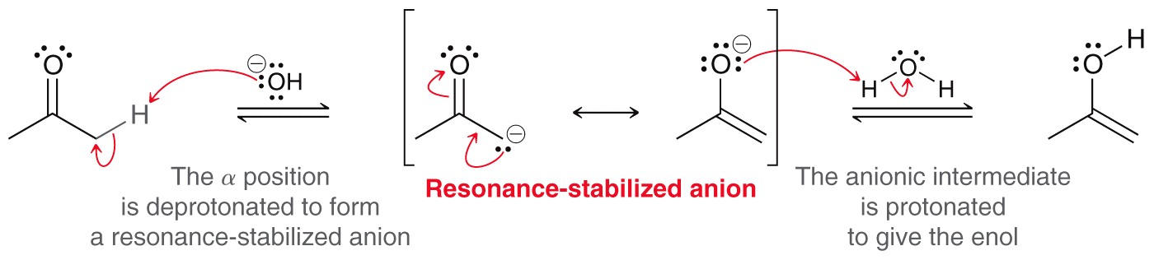
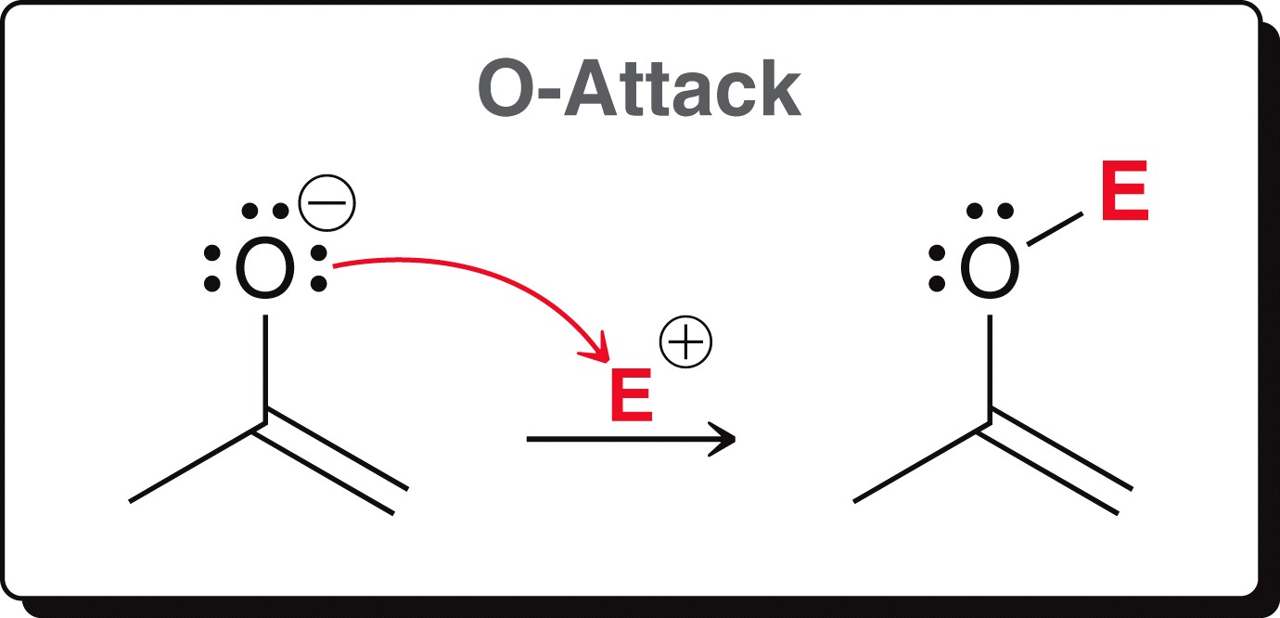
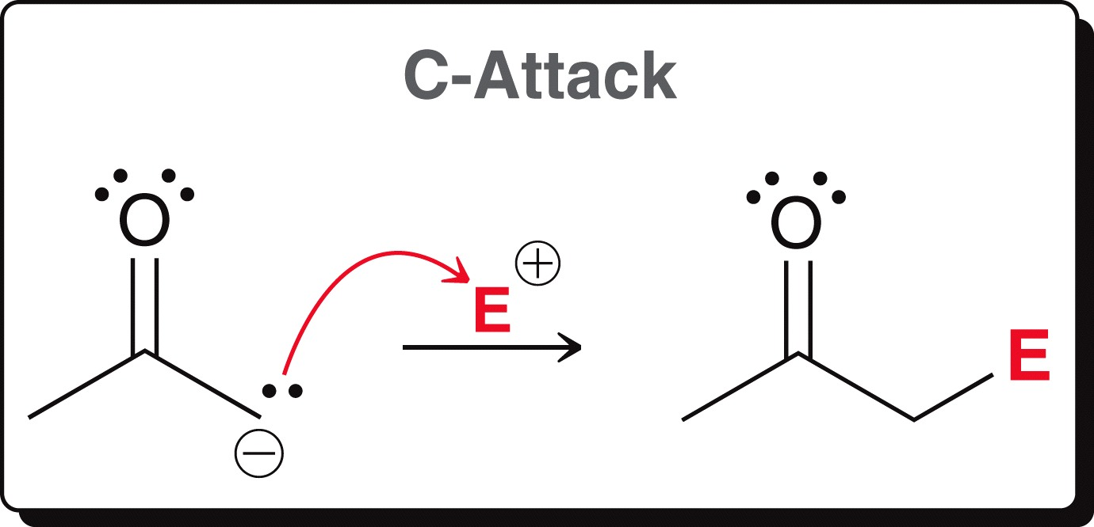
TAUTOMERIZATION
Mechanism of tautomerization
Practice 22.4 P. 1049, 22.6 P. 1052
Problems 22.57 to 22.61 P. 1096
Because the enolate has two nucleophilic sites (the oxygen and the a carbon), it can react at either of these sites. The reaction usually takes place primarily at the α-carbon, forming a new C—C bond
LDA forms the enolate. The enolate acts as the nucleophile and attacks the partially positive carbon of the alkyl halide, displacing the halide and forming a C—C bond.

Slide 6
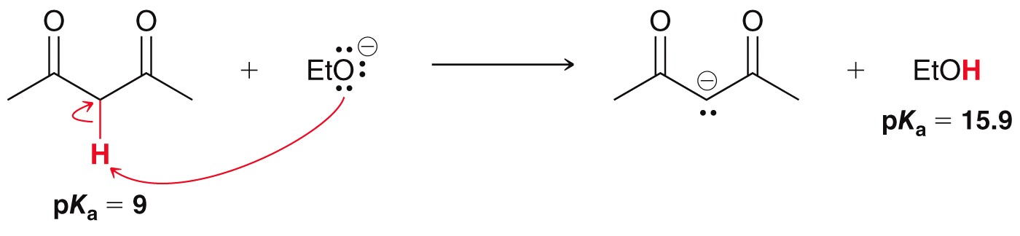
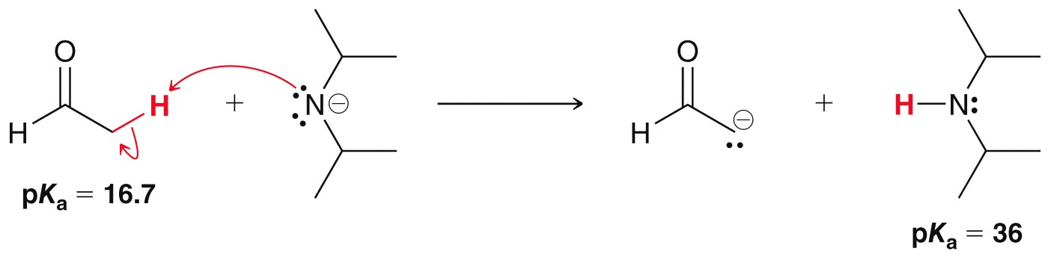
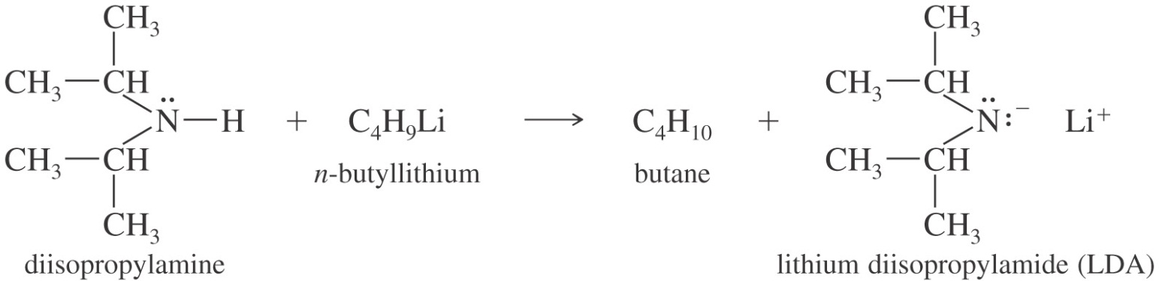
TAUTOMERIZATION
Enolate can undergo C-attack or O-attack
LDA

Slide 7
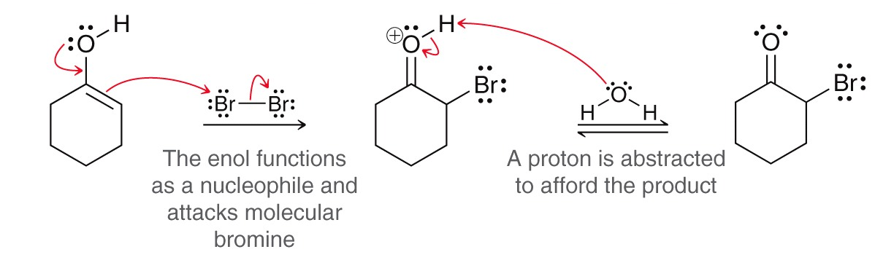
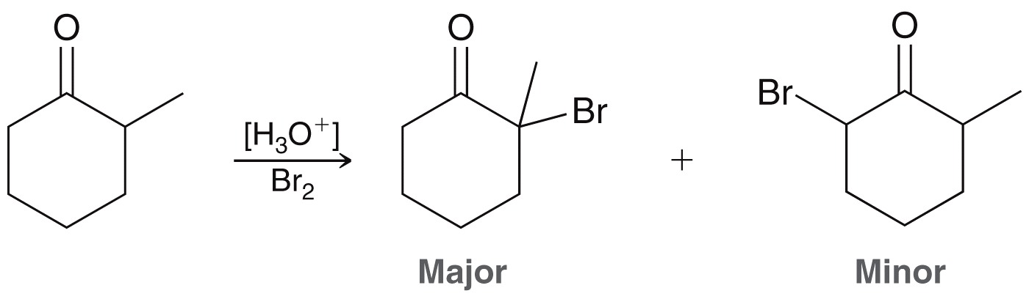
ALPHA-SUBSTITUTION
When a ketone is treated with a halogen and base, and α-halogenation reaction occurs.

Slide 8
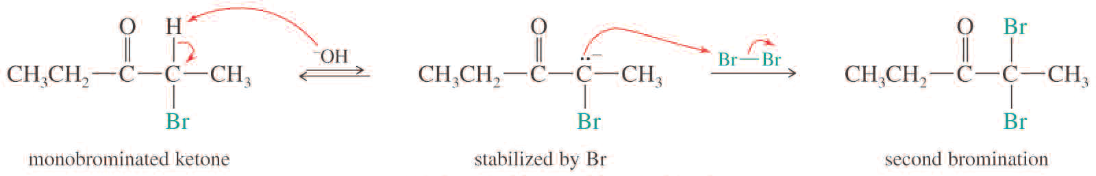
ALPHA-SUBSTITUTION
Multiple Halogenations
The α-haloketone produced is more reactive than ketone because the enolate ion is stabilized by the electron-withdrawing halogen
The second halogenation occurs faster than the first
Because of the tendency for multiple halogenations this base-promoted halogenation is not widely used to prepare monohalogenated ketones

Slide 9
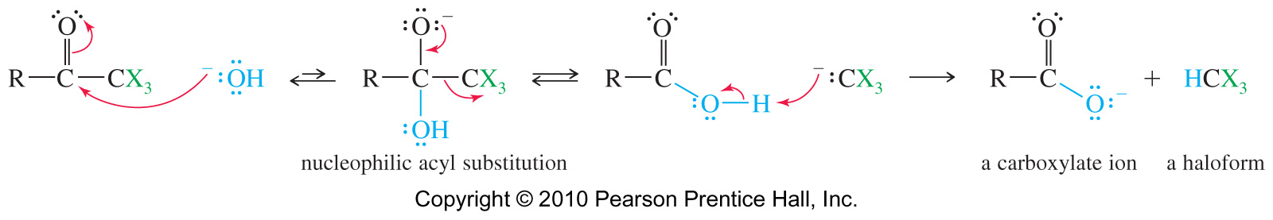
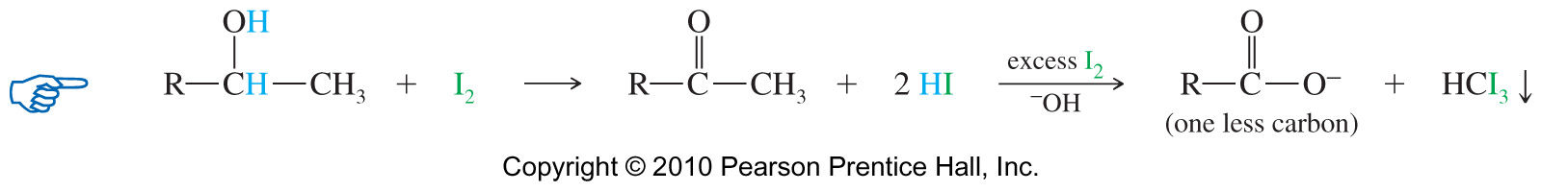
ALPHA-SUBSTITUTION
Haloform Reaction
With most ketones, base-promoted halogenation continues until the α-carbon atom is completely halogenated.
Methyl ketones have three α protons on the methyl carbon, and they undergo halogenation three times to give trihalomethyl ketones (haloform).
The trihalo ketone then reacts with hydroxide ion to give carboxylic acid.
If the iodine oxidizes the alcohol to a methyl ketone, the alcohol will give a positive iodoform test.
Iodoform (CHI₃) is a yellow solid that will precipitate out of solution

Slide 10
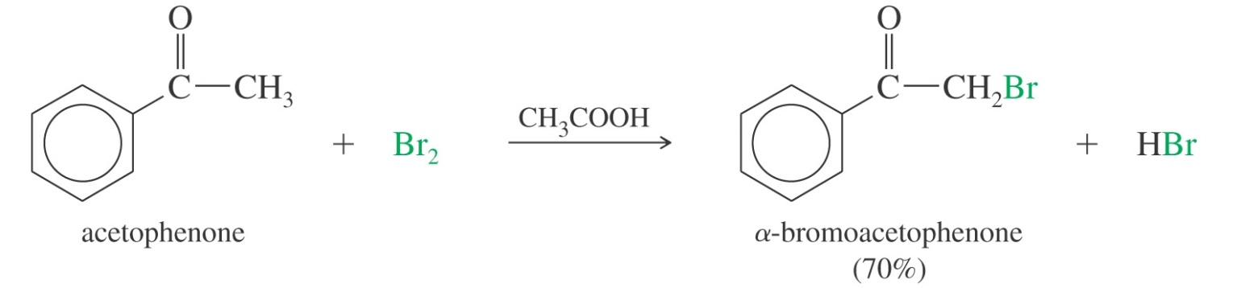
ALPHA-SUBSTITUTION
Ketones also undergo acid-catalyzed a halogenation.
Acidic halogenation may replace one or more alpha hydrogens depending on how much halogen is used.
Acetic acid serves as both the solvent and the acid catalyst.
Unlike ketones, aldehydes are easily oxidized by halogens to yield carboxylic acid.

Slide 11
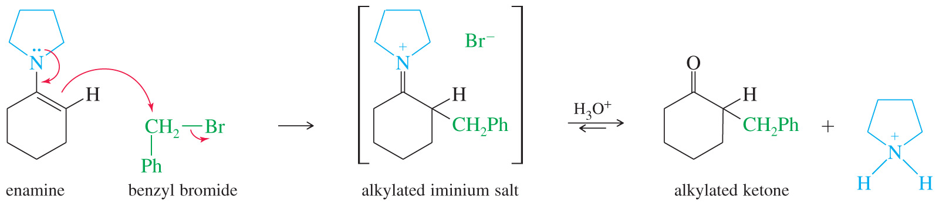
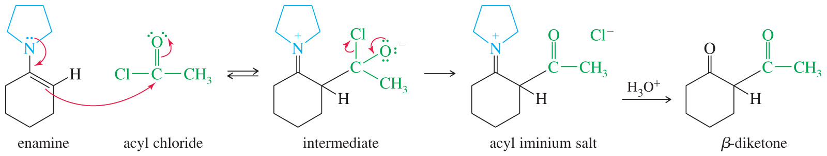
ALPHA-SUBSTITUTION
Enamines displace halides from reactive alkyl halides, giving alkylated iminium salts
The alkylated iminium salt can be hydrolyzed to the ketone under acidic conditions
Stork Reaction
A milder alternative to direct alkylation of enolate ions is the formation and the alkylation of an enamine derivative.
Ketone + 2° amine → enamine, then enamine is α-alkylated, then hydrolyzed.

Slide 12
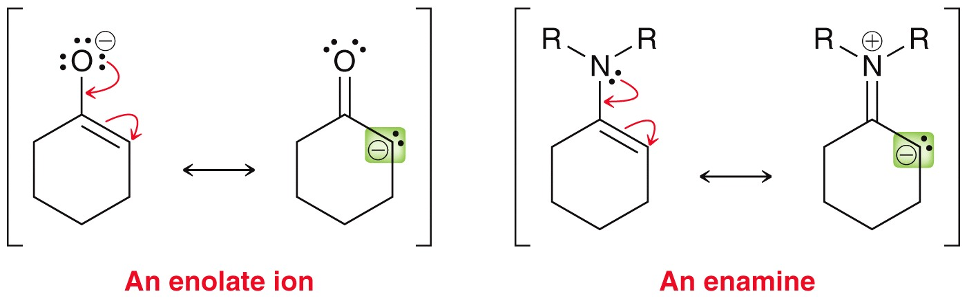
ALPHA-SUBSTITUTION
Ketones or aldehydes react with a secondary amine to form enamines.
The enamine has a nucleophilic α-carbon, which can be used to attack electrophiles.
Enolates and enamines have reactivity in common
An enamine results from the reaction of a ketone or aldehyde with a secondary amine

Slide 13
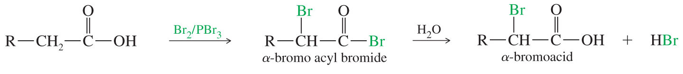
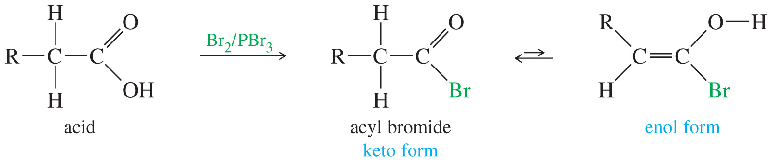
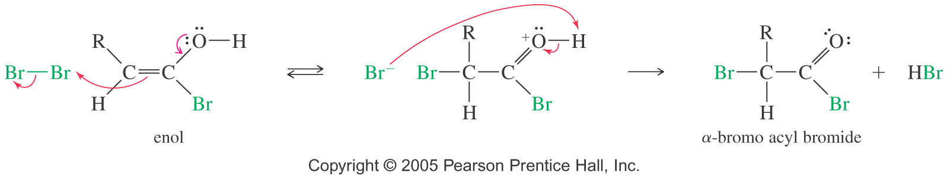
ALPHA-BROMINATION OF ACIDS
The HVZ Reaction
The Hell-Volhard-Zelinsky reaction replaces the α-hydrogen of a carboxylic acid with Br.

Slide 14
ALPHA-SUBSTITUTION
Examples: Predict the products of the following reactions

Slide 15
ALPHA-HALOGENATION
Show how you would accomplish the following conversion in good yield
Practice 22.9 , 20.10 22.11 to 22.14 P. 1054 – 1056

Slide 16
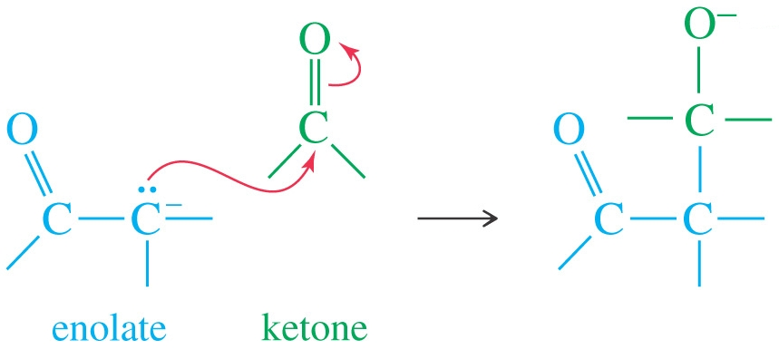
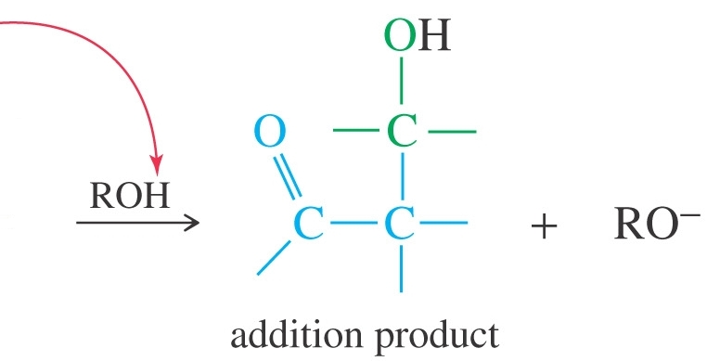
ALDOL CONDENSATION
Carbonyl condensation is alpha substitutions where the electrophile is another carbonyl compound.
First, the enolate ion attacks a C=O and the alkoxide formed is protonated. The net result is addition.
Under basic conditions, the aldol condensation involves the nucleophilic addition of an enolate ion to another carbonyl group.
When the reaction is carried out at low temperatures, the β-hydroxy carbonyl compound can be isolated.

Slide 17
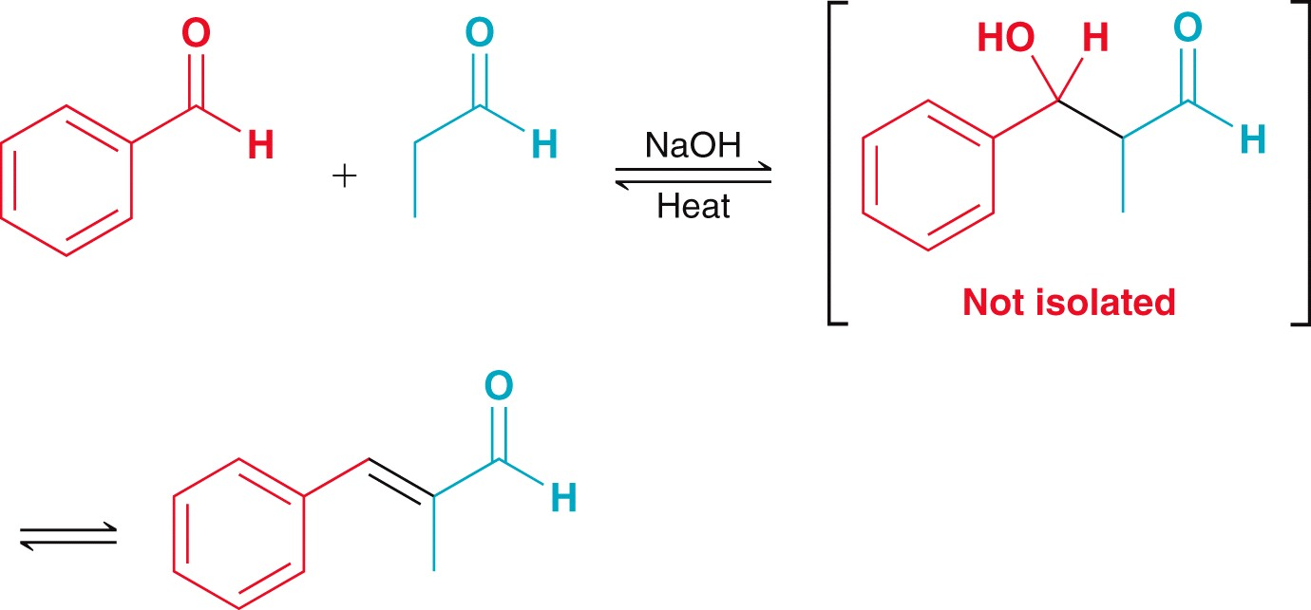
ALDOL CONDENSATION
Heating will dehydrate the aldol product to the α,β unsaturated compound
These reactions can either be acid- or base-catalyzed.
Under basic conditions, the aldol condensation occurs by a nucleophilic addition of the enolate ion (a strong nucleophile) to a carbonyl group.
Under acid conditions, the enol serves as a weak nucleophile to attack an activated (protonated) carbonyl group.

Slide 18
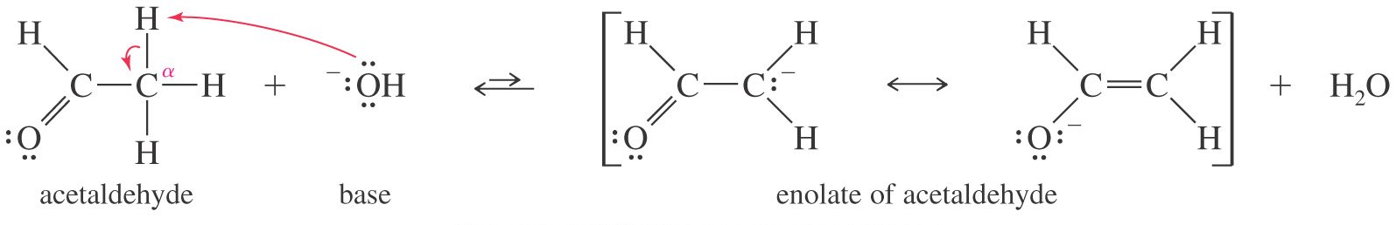
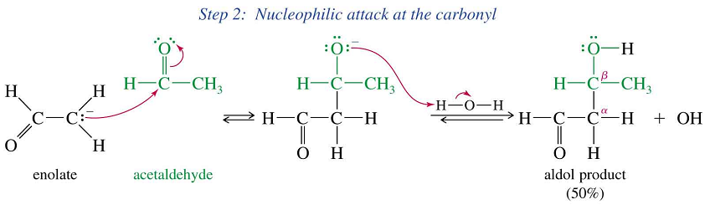
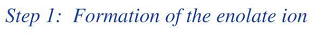
ALDOL CONDENSATION
Base-catalyzed: mechanism

Slide 19
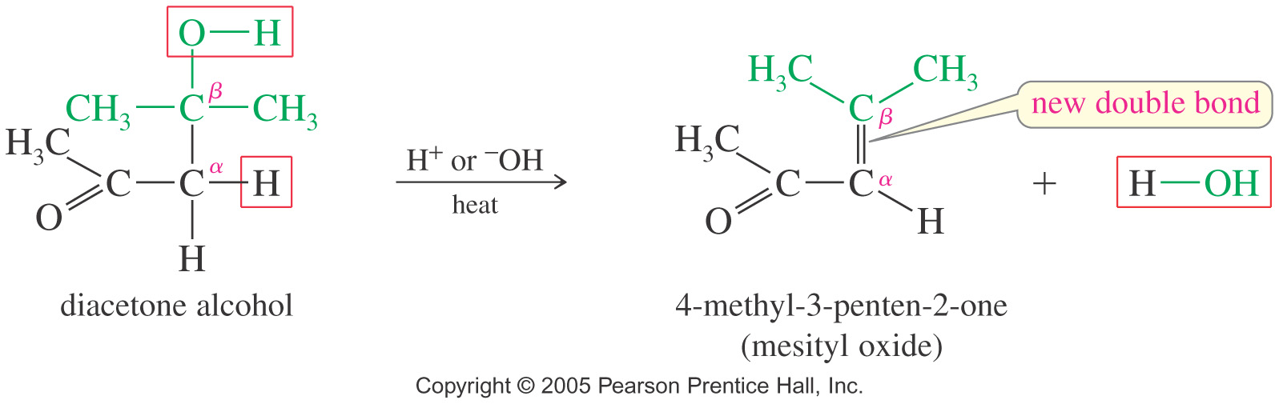
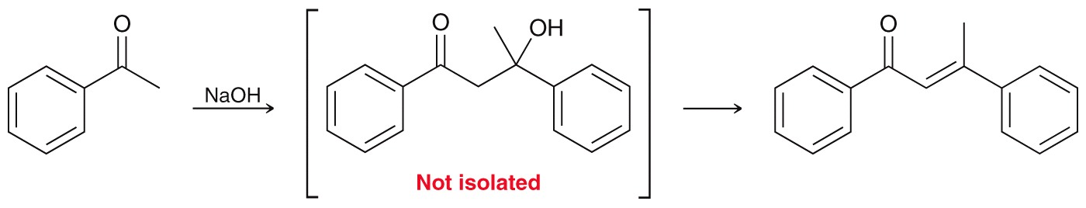
ALDOL CONDENSATION
Dehydration of Aldol
Heating a basic or acidic aldol dehydration of the alcohol functional group
The product is a α,β-unsaturated conjugated aldehyde or ketone
An Aldol condensation, followed by dehydration, forms a new carbon–carbon double bond

Slide 20
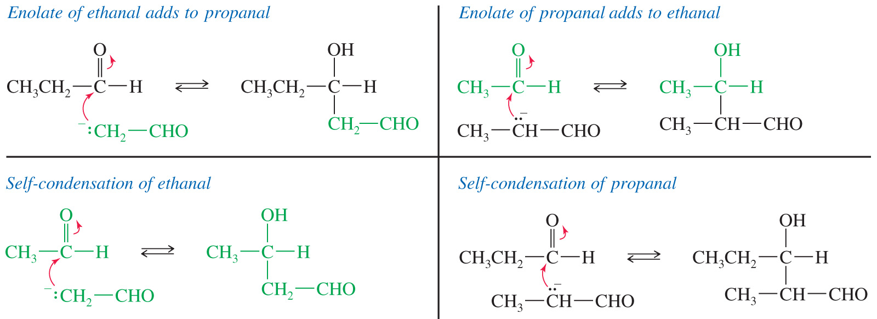
ALDOL CONDENSATION
Crossed Aldol Condensations
When the enolate of one aldehyde (or ketone) adds to the carbonyl group of another, the result is called a cross aldol condensation.
The compounds used in the reaction must be selected carefully, or a mixture of several products will be formed.

Slide 21
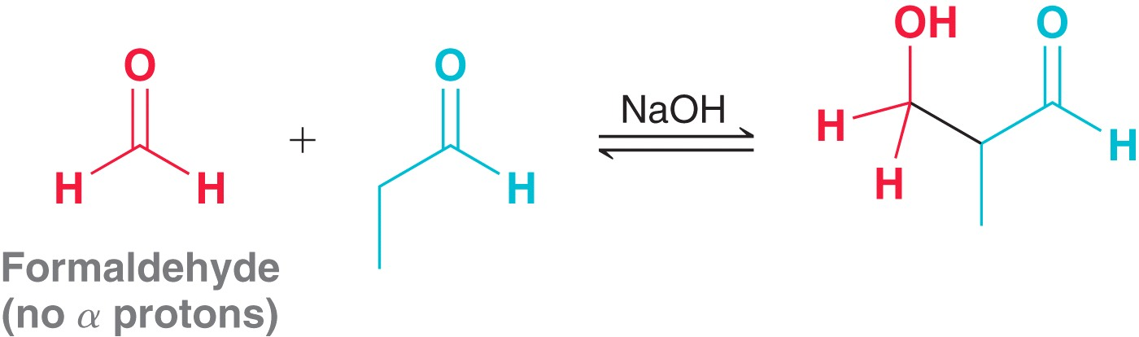
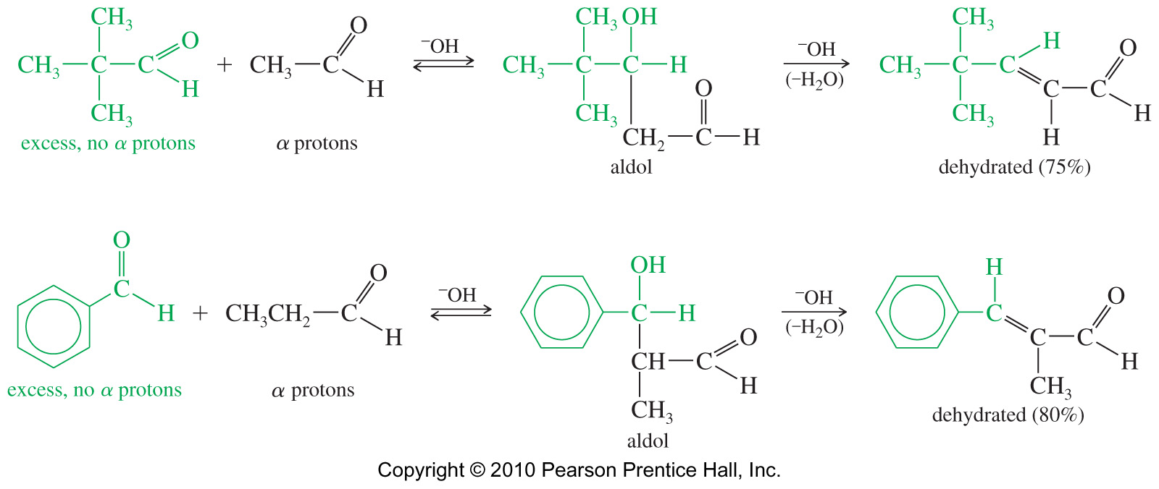
ALDOL CONDENSATION
Crossed Aldol Condensations
To be selective, only one of the reactants should have an alpha hydrogen

Slide 22
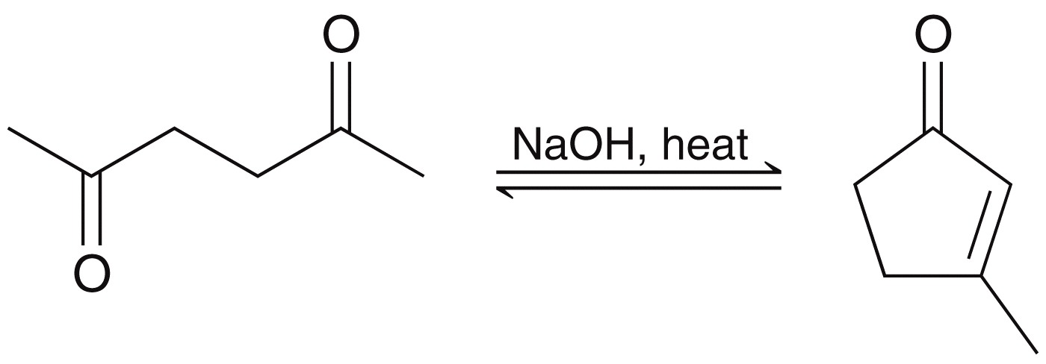
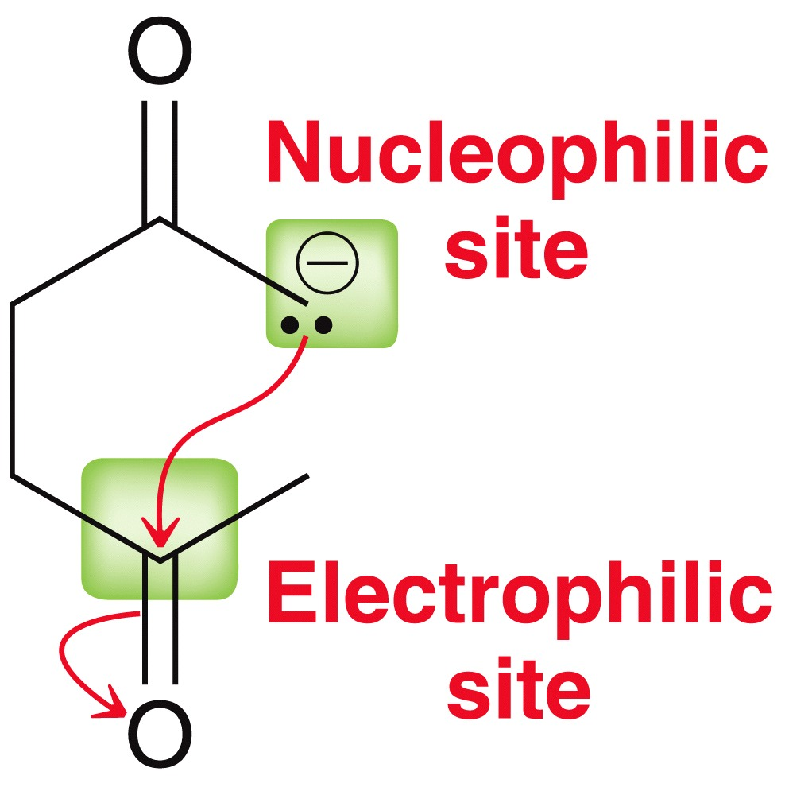
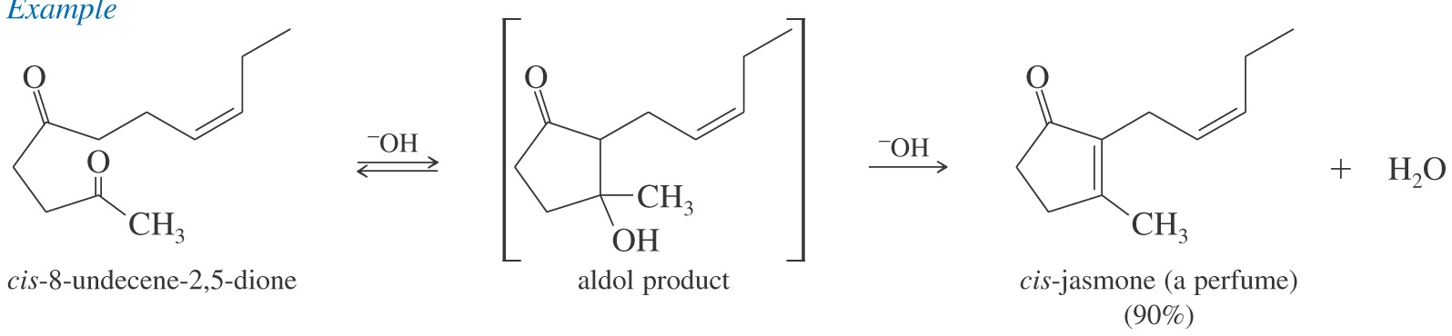
ALDOL CONDENSATION
Aldol Cyclization
Intramolecular aldol reactions of diketones are often used for making five- and six-membered rings.
Rings smaller or larger than five or six members are not favored due to ring strain or entropy
1,4-diketone forms cyclopentenone and 1,5-diketone forms cyclohexenone

Slide 23
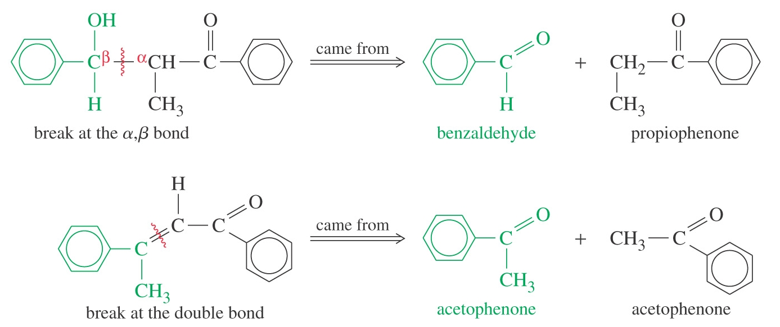
ALDOL CONDENSATION
Planning Aldol Synthesis: Retro-synthesis of Aldol Condensation
As long as we remember their limitations, aldol condensations can serve as useful synthetic tools for making a variety of organic compounds.

Slide 24
ALDOL CONDENSATION
Examples: Predict the products of the following reactions
Show how you would accomplish the following conversion in good yields
Practice 22.15, 22.16 P. 1059
22.20, 22.21 P. 1064
Practice 22.23, 22.24 P. 1067

Slide 25
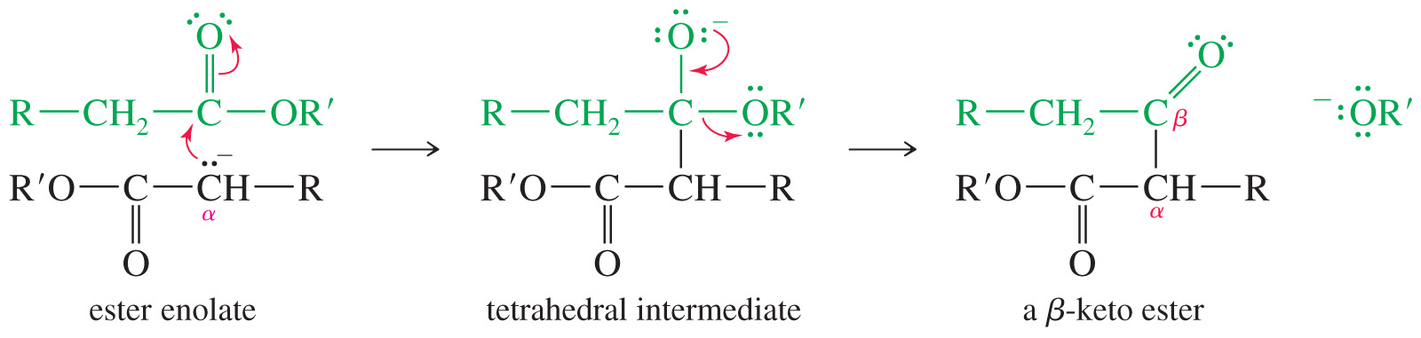
CLAISEN CONDENSATION
In an alpha condensation, if the electrophile is an ester, the ester undergoes a nucleophilic acyl substitution, with the enolate ion serving as the nucleophile.
The loss of alkoxide ion results in nucleophilic acyl substitution.
The α hydrogens of esters are weakly acidic, and they can be deprotonated to give enolate ions.
The Claisen condensation results when an ester molecule undergoes nucleophilic acyl substitution by an enolate
If two esters combine they form a β-keto ester.

Slide 26
CLAISEN CONDENSATION
Examples: Predict the products of the following reactions
Show how you would prepare the following compounds using Claisen condensation

Slide 27
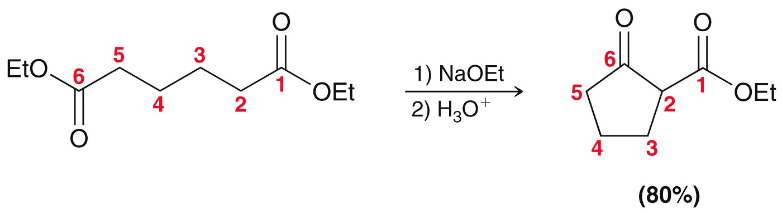
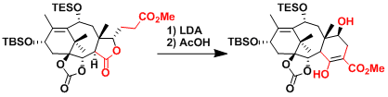
CLAISEN CONDENSATION
Dieckmann Condensation
An internal Claisen condensation of a diester forms a ring. Such an internal Claisen cyclization is called a Dieckmann condensation or Dieckmann cyclization.
A 1,6 diester → cyclic (5) β-keto ester, and a 1,7 diester → cyclic (6) β-keto ester

Slide 28
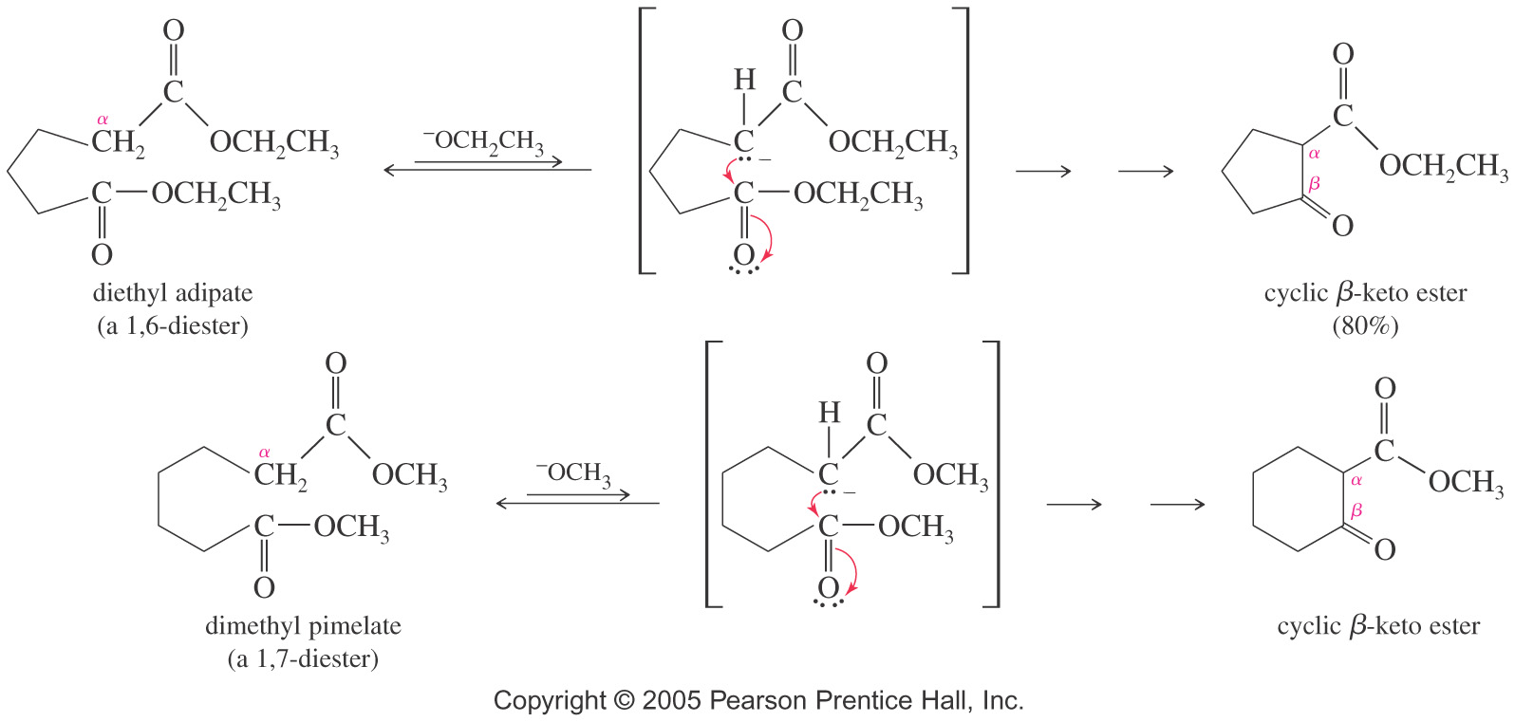
CLAISEN CONDENSATION
Dieckmann Condensation: Mechanism
Crossed Claisen Condensation
Two different esters can be used, but one ester should have no α-hydrogens
Useful esters are benzoates, formates, carbonates, and oxalates
In a crossed Claisen condensation, an ester without a hydrogen serves as the electrophilic component

Slide 29
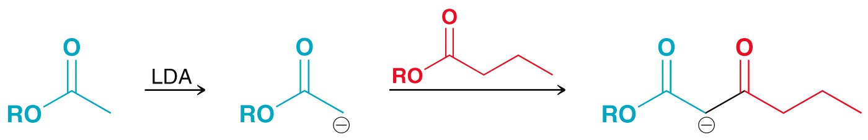
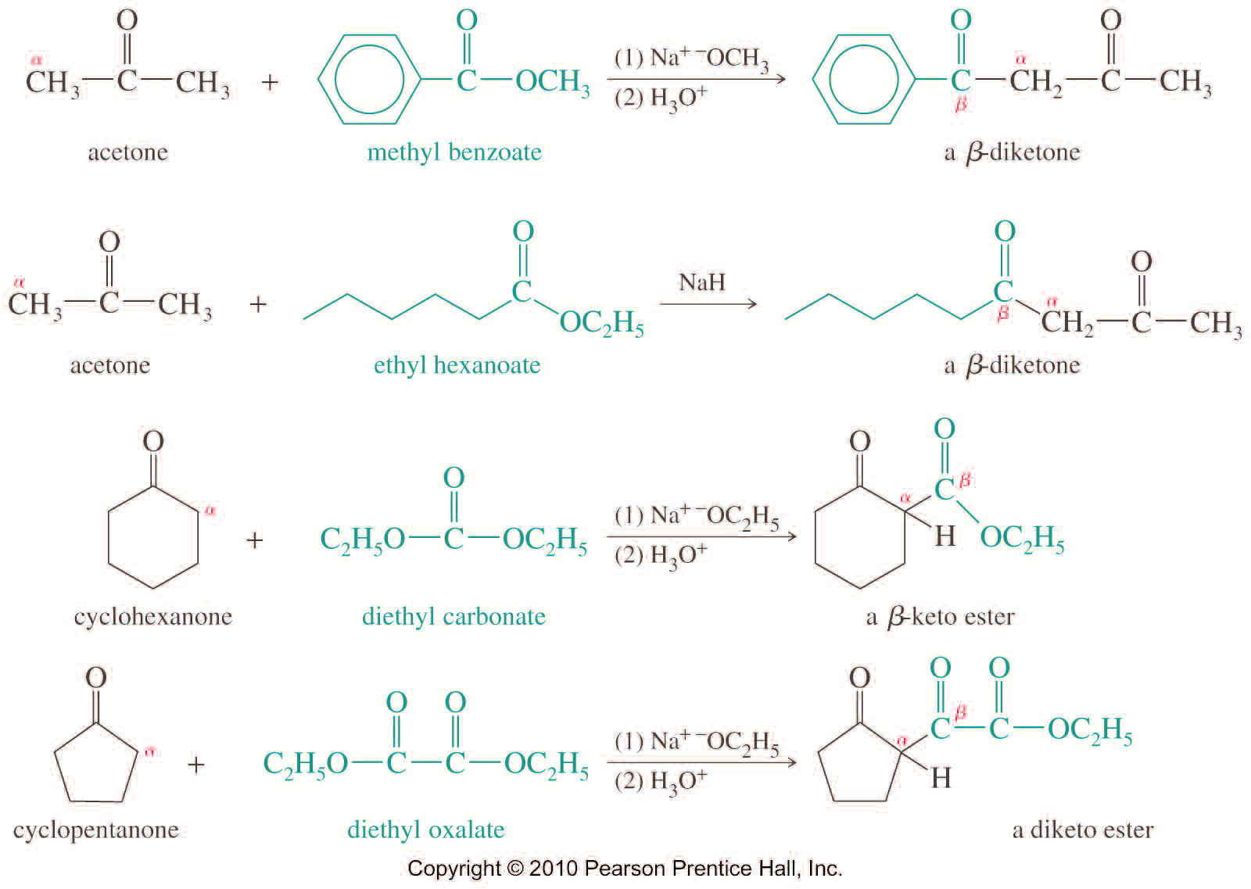
CLAISEN CONDENSATION
Claisen Condensation
Practice 22.28 to 22.32 P. 1071, 22.33 P. 1073

Slide 30
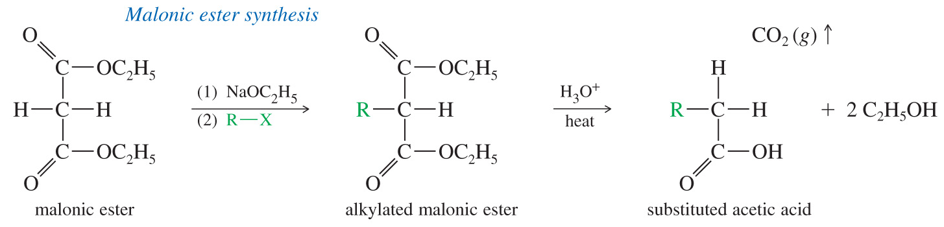
CLAISEN CONDENSATION
Synthesis using β-Dicarbonyl Compounds
Many alkylation and acylation reactions are more effective using anions of β-dicarbonyl compounds that can be completely deprotonated and converted to their enolate ions by common bases such as methoxide ion and ethoxide ion.
The malonic ester synthesis and the acetoacetic ester synthesis use enhanced acidity of the α protons in malonic ester and acetoacetic ester to accomplish alkylation and acylations that are difficult or impossible with simple esters.
At the end of the synthesis, hydrolysis removes one of the carboxyl groups.
The malonic ester synthesis makes substituted derivatives of acetic acids

Slide 31
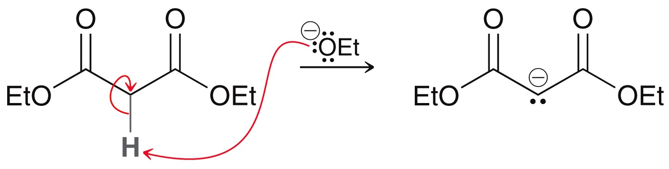
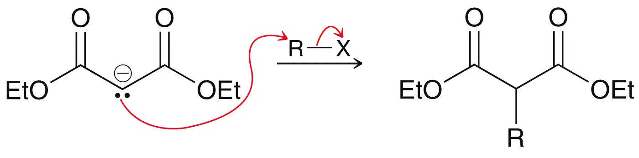

CLAISEN CONDENSATION
Synthesis using β-Dicarbonyl Compounds

Slide 32


CLAISEN CONDENSATION
Malonic Ester Synthesis

Slide 33


CLAISEN CONDENSATION
Acetoacetic Acid Synthesis
The acetoacetic ester synthesis is similar to the malonic ester synthesis, but the final products are ketones
Acidic hydrolysis of the alkylacetoacetic ester initially gives an alkylacetoacetic acid, which is a β-keto acid
The keto group in the β-position promotes decarboxylation to form a substituted version of acetone

Slide 34
CLAISEN CONDENSATION
Samples: Predict the products of the following reactions
Practice 22.35, 22.36 P. 1076
22.39 to 22.43 P. 1079

Slide 35


THE MICHEAL REACTION
α,β-Unsaturated carbonyl compounds have unusually electrophilic double bonds. The β carbon is electrophile because it shares the partial positive charge of the carbonyl carbon trough resonance.
A nucleophile can attack an α,β-unsaturated carbonyl compound at either the carbonyl group or at the β position.
The attack at the carbonyl group leads to a 1,2-addition, while the attack at the β position leads to a 1,4-addition.
A 1,4-addition of an enolate ion is called the Michael reaction.
Arthur Michael (August 7, 1853 – February 8, 1942) was an American organic chemist best known for the Michael reaction

Slide 36



THE MICHEAL REACTION
A 1,4-addition of an enolate ion is called the Michael reaction.

Slide 37


THE MICHEAL REACTION
Michael donors are enolate ions stabilized by two electron-withdrawing groups (β-diketone, β-keto ester, enamine, β-keto nitrile, α-nitro ketone).
Michael acceptors are C=C conjugated with carbonyl, cyano, or nitro group (conjugated aldehyde, ketone, ester, amide, nitrile, or a nitroethylene).
Conjugate addition of α,β-unsaturated carbonyls starts with attack at the beta position.

Slide 38


THE MICHEAL REACTION
Mechanism
Practice 22.44 to 22.46 P. 1081, 22.47, 22.48 P. 1085

Slide 39


THE MICHEAL REACTION

Slide 40

ADDITION ON METHYL VINYL KETONE
1,4-Addition of an Enolate to Methyl Vinyl Ketone (MVK)
An enolate will initiate a 1,4-attack on the α,β-unsaturated ketone (MVK).

Slide 41

THE ROBINSON ANNULATION
With enough base, the product of the Michael reaction undergoes a spontaneous intramolecular aldol condensation, usually with dehydration, to give a six-membered ring, α -conjugated cyclohexenone

Slide 42


THE ROBINSON ANNULATION
Mechanism for Robinson Annulation

Slide 43
THE ROBINSON ANNULATION
Samples: Predict the products of the following reactions
Show how you would synthesize the following compounds using Robinson Annulation
Practice 22.51 to 22.53 P. 1088
22.54 to 22.56 P. 1090
Problems 22.77 to 22.103 P. 1096-1099

